Slide 1
Site Map, HCRO
We want to install and off the shelf Radome to cover the ALPACA receiver and protect it from weather.
The installation location is marked in green.
Note, this is on Bidwell leased land

Slide 2
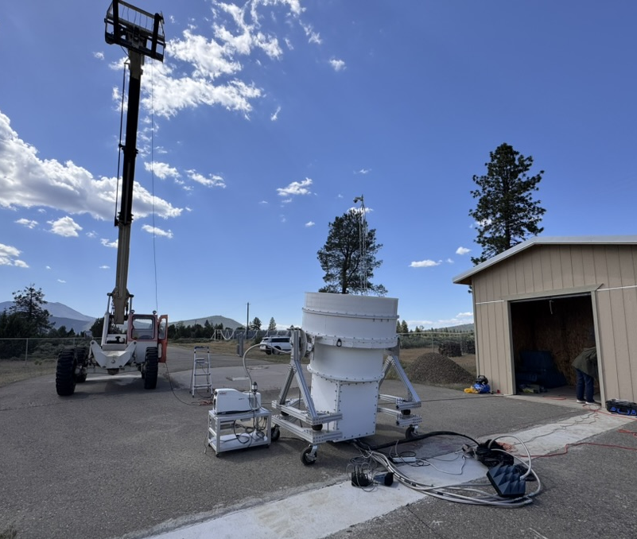
Picture showing the ALPACA receiver in place
The alpaca receiver is a mobile receiver on a frame with wheels and is being rolled in position to perform science observation.
We want to leave it at this location for a while and would like to cover it using a Radome.
ALPACA Receiver

Slide 3
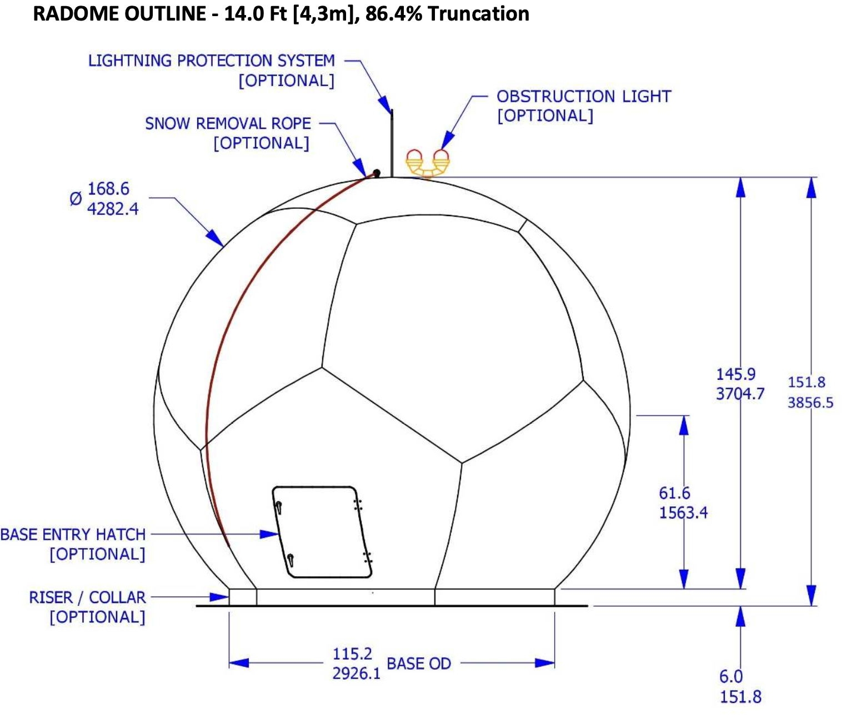
Image of the Radome
I also attached a document of the datasheet of the radome.
We would plan to assleble it in place and then lift it over the ALPACA receiver.
And when we want to do maintenance or move the receiver somewhere else we would lift it off and roll the receiver out.

